Slide 1

Software requirements (swr302)
Requirement elicitation (chapter 07)

Slide 2
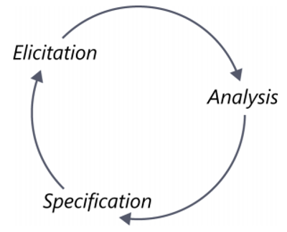
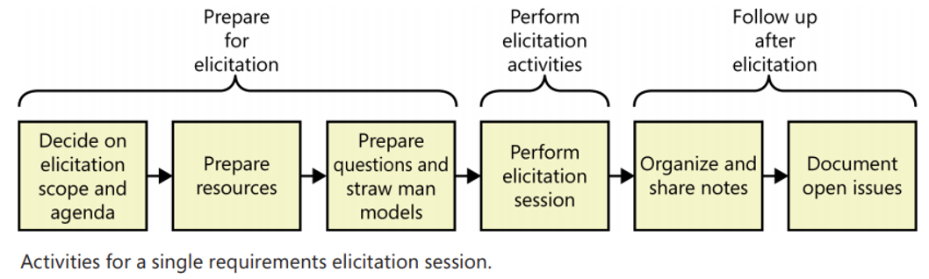
Overview
Elicitation Techniques
Interviews
Workshops
Focus groups
Observations
Questionnaires
System interface analysis
User interface analysis
Document analysis

Slide 3
Planning elicitation on your project
Elicitation objectives
Elicitation strategy and planned techniques
Schedule and resource estimates
Documents and systems needed for independent elicitation
Expected products of elicitation efforts
Elicitation risks

Slide 4
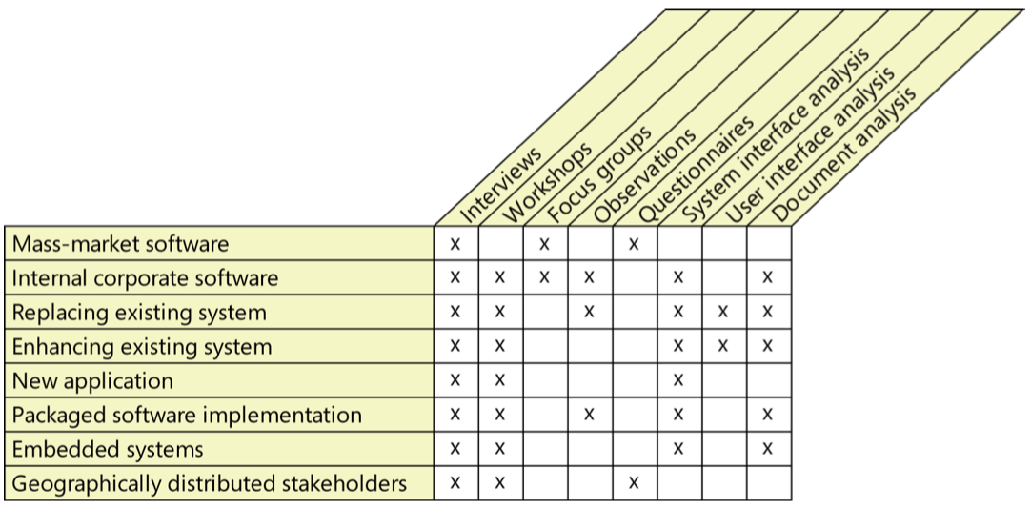
Planning elicitation on your project
Suggested elicitation techniques by project characteristic

Slide 5
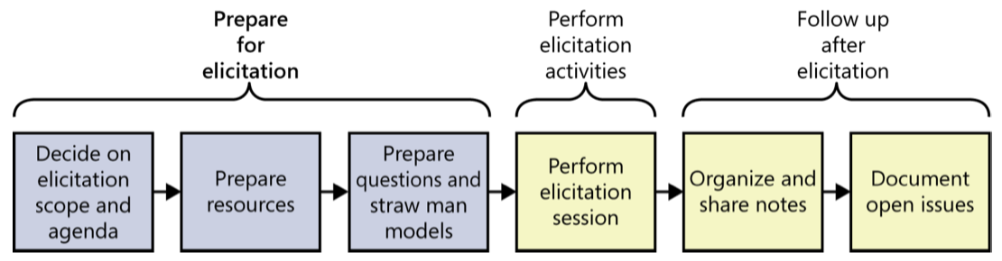
Preparing for elicitation
Plan session scope and agenda
Prepare resources
Learn about the stakeholders
Prepare questions
Prepare straw man models
Notes:
Some of the most useful models are use cases and process flows because they closely align with how people think about doing their jobs. Create straw man, or draft, models ahead of your elicitation sessions. A straw man serves as a starting point that helps you learn about the topic and inspires your users to think of ideas. It is easier to revise a draft model than to create one from scratch.

Slide 6
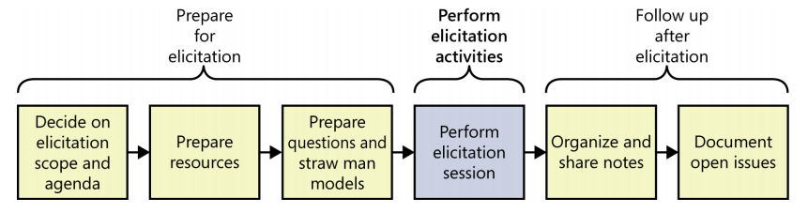
Performing elicitation activities
Educate stakeholders
Take good notes
Exploit the physical space

Slide 7
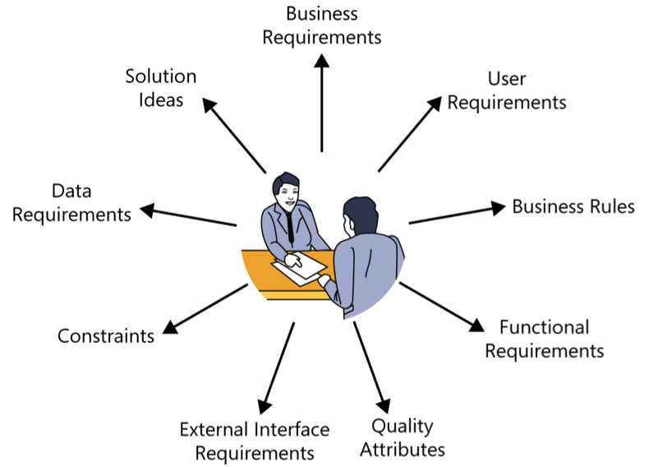
Following up after elicitation
Organizing and sharing the notes
Documenting open issues
Notes:
Anything that doesn’t fit into one of these categories might be:
A project requirement not related to the software development, such as the need to train users on the new system.
A project constraint, such as a cost or schedule restriction (as opposed to the design or implementation constraints described in this chapter).
An assumption or a dependency.
Additional information of a historical, context-setting, or descriptive nature.
Extraneous information that does not add value.

Slide 8


